Slide 1





High-Resolution Data Visualization Using Rocks Clusters
Student: Aaron Robinson
Project Advisor: Dr. Bruce Segee
Local Advisor: Roger Shore
November 13, 2009

Slide 2
Introduction
Need for visualizing larger data sets
  Scientific Modeling
  Medical Imagery
Rocks Cluster
  Open source Linux cluster distribution
  Provides easy cluster administration
  Provides visualization roll

Slide 3
Related Works
LionEyes Display Wall (Penn State)
  Resolution: 4096x2304
  12 projectors
  12 dual Xeons w/ NVIDIA Quadro 900 XGL (render)
  2 Xeons w/ NVIDIA Quadro 900 XGL (application)

Slide 4
Related Works Cont.
Hyperwall-2 (NASA Advanced Supercomputing)
  Estimated Resolution: 25600x8192
  128 LCD screens
  128 GPUS
  1,024 cores
  74 teraflops

Slide 5
Two Considerations
Physical Display
  Back Projection
  Liquid Crystal Displays
Rendering Technique
  Rendering and displaying on the same machine
  Rendering and displaying on separate machines

Slide 6
Rocks Clusters
SQL Database & Master Repository
Back-end nodes connect via PXE or CD
Red Hat Kickstart
Package downloading via torrent
New nodes exchange packages without front-end
Cluster DB used for propagating configuration changes

Slide 7
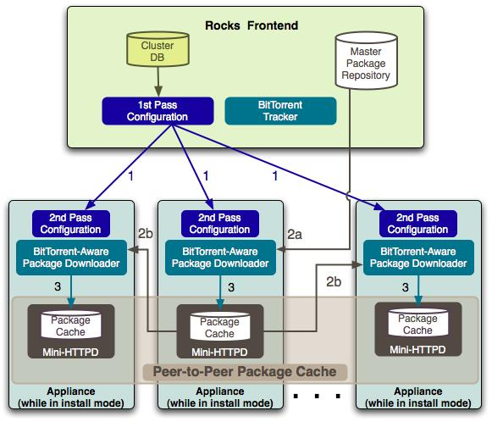

Slide 8
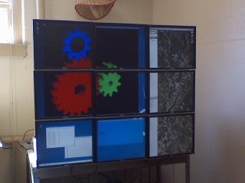
DMX & Xinerama
DMX (Xdmx) - multiple displays from multiple machines
Xinerama - multiple displays unified as single screen

Slide 9
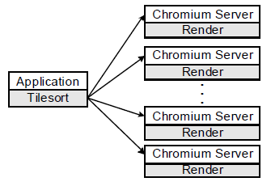
Chromium
Manipulates OpenGL for graphics cluster
Stream Processing Unit (SPU)
Mothership
Tilesort SPU
Render SPU

Slide 10
SAGE
Stream graphics from rendering cluster
Collaborative environment
Components:
Free Space Manager
SAGE Application Interface Library (SAIL)
SAGE Receiver
User Interface (UI)

Slide 11
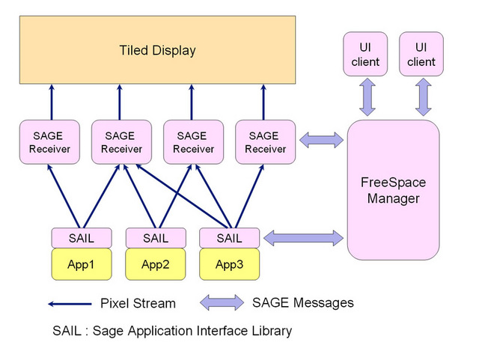

Slide 12
Results
Ubuntu 9.04
  Xdmx seg fault (xdmx_1.6.1.901-3_i386.deb)
  Chromium only locally
Rocks 4.2.1
  Limited Viz Roll
Rocks 5.0
  Full-functional Viz configuration
  Latest version for i386
  Last roll containing Xdmx

Slide 13
UMaine 3x3 Display Wall
Dual Pentium 3s (Application/Head-node)
3 Dual Pentium 3s (Render)
3 Geforce4 MX 4000s 128MB (per render)
3840x3072 resolution
60 Frame Per Second

Slide 14
UMaine 4x4 Display Wall
Dual Xeon Quad-Core (Application/Head-node)
2 Core 2 Quad-Core (Render)
4 nVidia 8600GT Dual-DVI 256MB (per render)
5120x4096 resolution
60 Frame Per Second

Slide 15
Acknowledgment
National Science Foundation (Grant 0754951)
Department of Defense
Supercomputing REU program (SuperME)
The University of Maine
High Point University

Slide 16

Questions

